Slide 1


Engineering Physics (EN3BS05)
Ms Bhawna Kshirsagar
Medi-Caps University, Indore

Slide 2
Syllabus
Unit 1. Lasers and Optical Fibre
Unit 2. Interference and Diffraction
Unit 3. Quantum Mechanics
Unit 4. Mechanics and Crystal Physics
Unit 5. Polarization, Acoustics and Superconductivity

Slide 3
Scheme 3-1-2
3- Lectures
1- Tutorial
2- Laboratory Work
Total Credit: 5
Ms. Bhawna Kshirsagar , Assistant Professor (Physics Department) Medi-Caps University, Indore

Slide 4
EN3BS05 Engineering Physics 3-1-2
Text Books
Text Book of Optics by S. Chand Publication
Gour and Gupta , Engineering Physics, Dhanpat Rai Publication
S. L. Gupta, Engineering Physics
Text Book of Engineering Physics by M.N. Avadhanulu and P.G. Kshirsagar (Acoustics, Superconductivity)
Reference Books
Dr. M. N. Avadhanulu, Dr. R. S. Hemne, An Introduction to Laser- Theory and Applications. S. Chand Publications
Web Resources
http://phet.colarado.edu/en/simulations.
http://nptel.ac.in/courses/122103011/39.
Ms. Bhawna Kshirsagar , Assistant Professor (Physics Department) Medi-Caps University, Indore

Slide 5
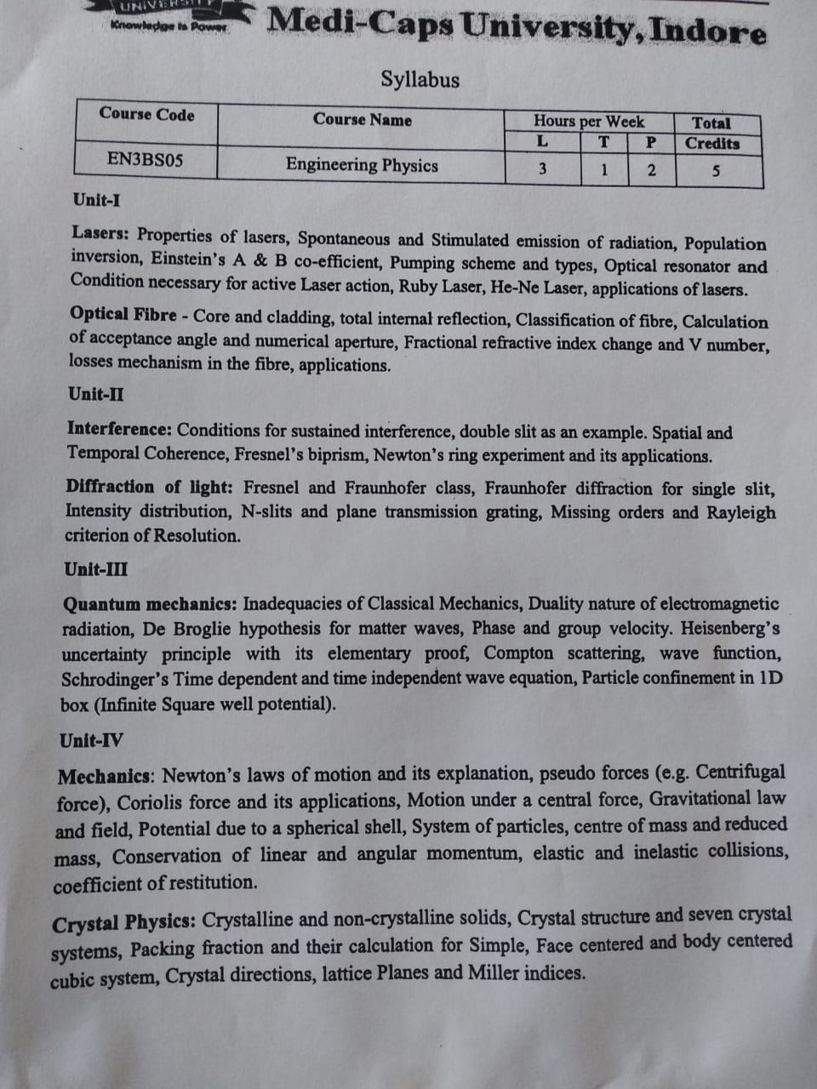

Slide 6
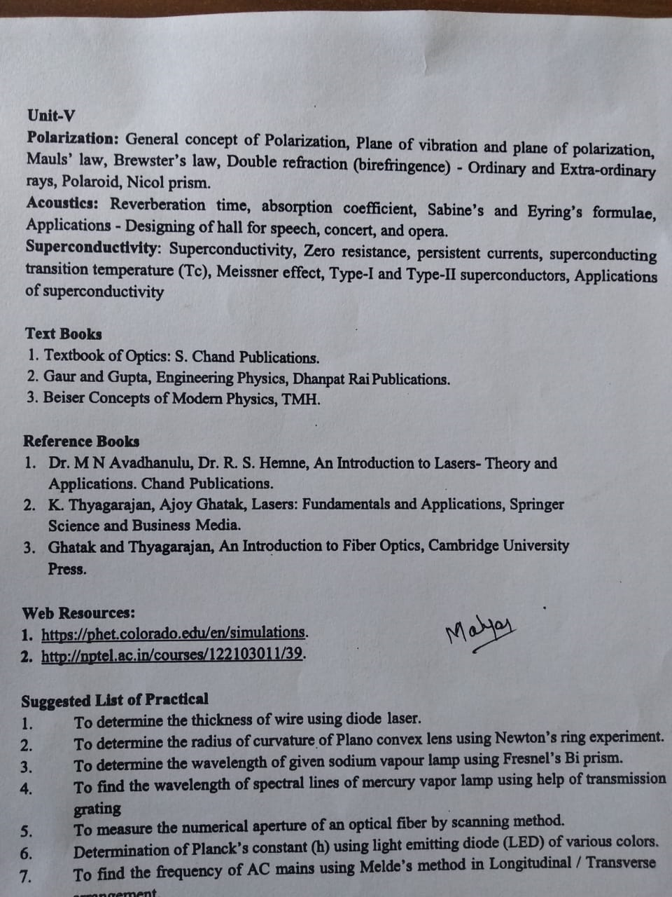

Slide 7
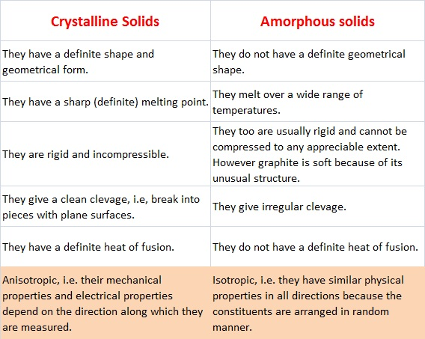
Unit IV CRYSTAL STRUCTURE

Slide 8
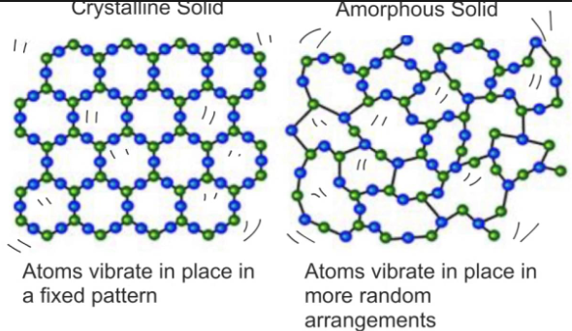
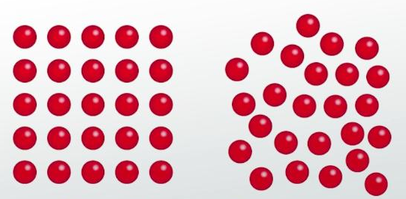

Slide 9
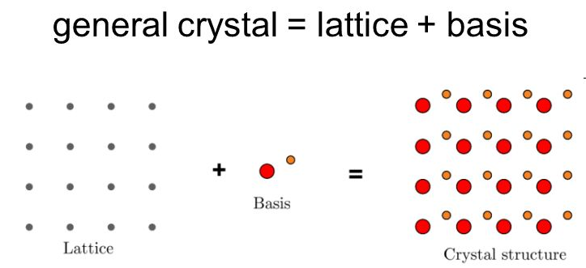
Crystal Structure
Lattice: It is an arrangement of points in space in which environment of any two points is identical.
Basis: The atom or molecule associated with lattice point is called basis.

Slide 10
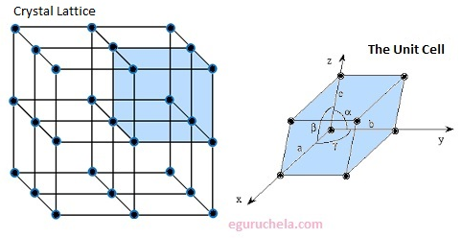
Unit cell: Smallest unit repetition of which crystal structure is obtained.

Slide 11
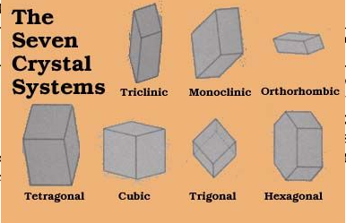
Seven System of Crystal

Slide 12
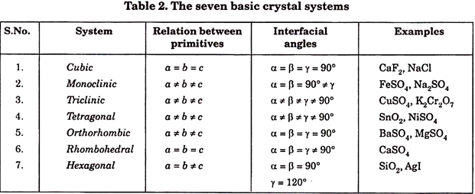

Slide 13
Characteristics of the Unit Cell
In this section, we discuss some of the important parameters, which are used to describe the crystal structure of the material. A unit cell is characterized by the following parameters.
· Number of atoms per unit cell.
· Coordination number
· Atomic Radius
· Packing factor (or) packing density
No of atoms per unit cell:
The number of atoms possessed by a unit cell is known as number of atoms per unit cell.
The distribution of atoms is different for different lattice structure. This can be determined if the arrangement of atoms inside the cell is known.

Slide 14
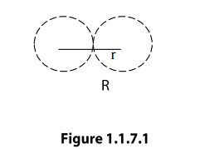
Coordination Number
The coordination number of an atom in a crystal is the number atoms directly surrounding with that atom. If the coordination number is high, then the structure will be more closely packed. It signifies the tightness of packing of atoms in the crystal.
Atomic radius
Atomic radius is defined as half of the distance between any two nearest neighboring atoms, which have direct contact with each other, in a crystal of a pure element. It is usually expressed in terms of cube edge ‘a’(Lattice paramenter).

Slide 15
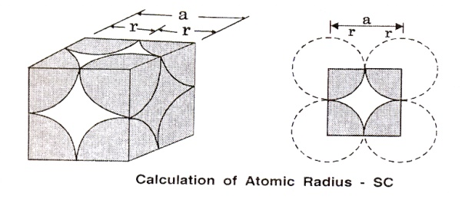
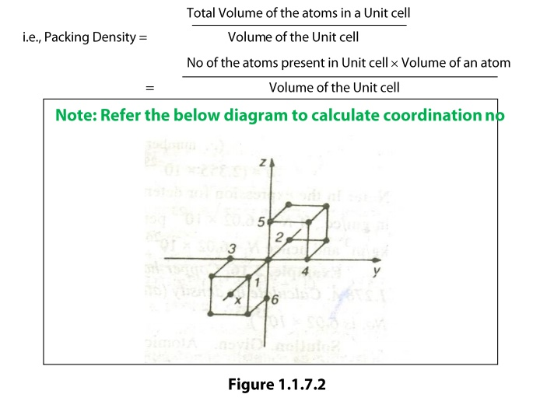
Packing Factor
Packing Factor
The packing density is the ratio between the total volume occupied by the atoms or the molecule in an unit cell and the volume of the unit cell.

Slide 16
1. Simple Cubic Crystal
A simple cubic (SC) unit cell consists of eight corner atoms as shown in the figure
(i) Number of atoms per unit cell
In actual crystal, each and every corner atoms is shared by eight adjacent unit cells. Therefore, each and every corner atoms contribute 1/8 of its part to one unit cell. Hence the total number of atoms present in the unit cells is 1/8 x 8 = 1 atom.
(ii) Coordination number
The coordination number of a simple cubic unit can be calculated as follows. Let us consider any corner atom; there are four nearest neighbors in its own plane. There is another nearest neighbor in a plane, which lies just above this atom, and another just below this atom. Therefore, the total number of nearest neighbors is six and hence the coordination number is 6.
(iii) Atomic radius
For a simple cubic unit cell, the atomic radius is given by, r=a/2, where ‘a’ is the side of the unit cell and is equal to the distance between centers of the two nearest atoms.

Slide 17
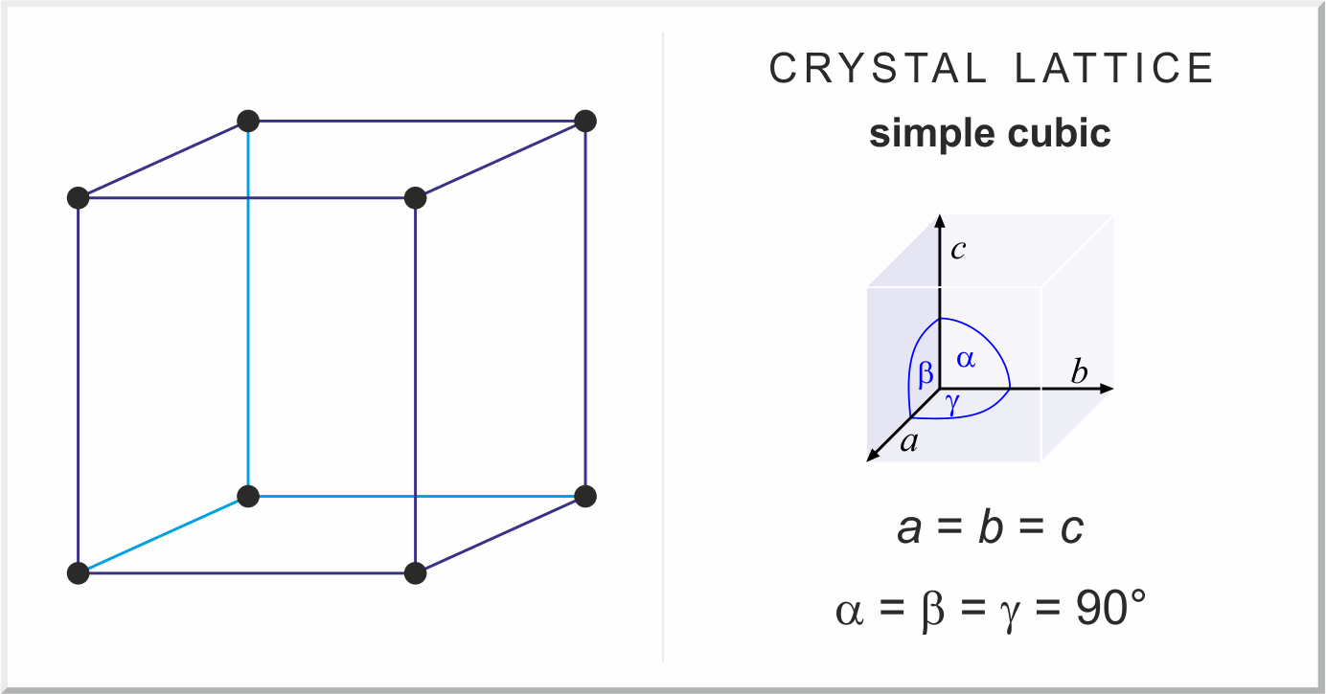
SCC

Slide 18
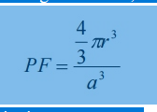
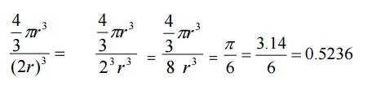
Simple Cubic Crystal
(iv) Packing factor
Number of the atoms per unit cell=1
Volume of one atom v = 4/3 πr³
Where r is the atomic radius
Side of the unit cell, a=2r
Atomic radius r=a/2
Total volume of the unit cell V=a³
We know the packing factor= v/V
Substituting for v and V, we have
Substituting a=2r , we get
Thus 52% of the volume of the simple cubic unit cell is occupied by atoms and the remaining 48% of the volume of the unit cell is Vacant.

Slide 19
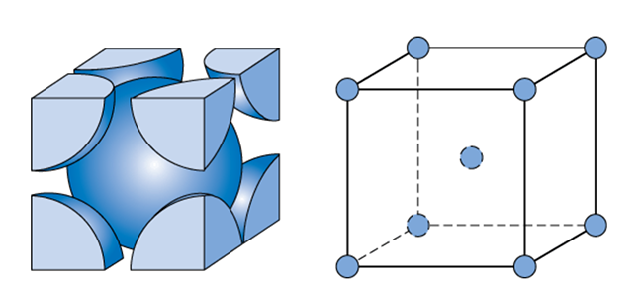
2. BCC
In body centered cubic structure, the unit cell has one atom at each corner of the cube and one at body center of the cube. Figure 3.8 shows the arrangement of the atoms in a bcc cell.
(i) Number of atoms per unit cell
In a body centered crystal structure, the atoms touch along the diagonal of the body. Each and every corner atoms are shared by eight adjacent unit cells. Therefore, the total number of atoms contributed by the corner atoms is 1/8 x 8 =1 atom.
One full atom at the center of the unit cell = 1 atom
Therefore, total number of atoms present in the bcc unit cell = 1+1 = 2 atoms.

Slide 20
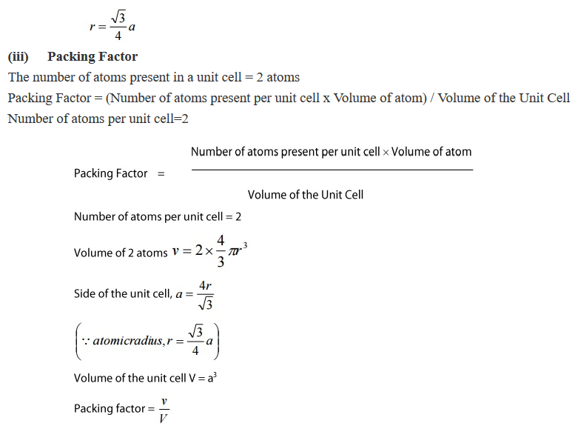
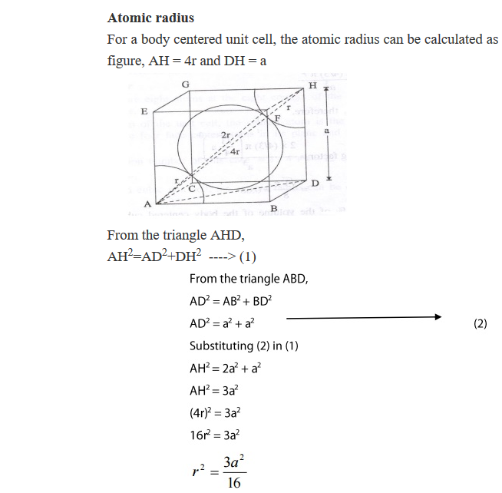
BCC

Slide 21
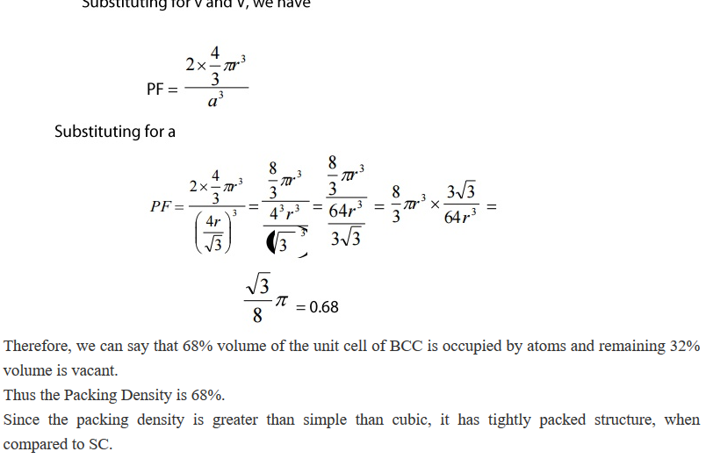
BCC

Slide 22
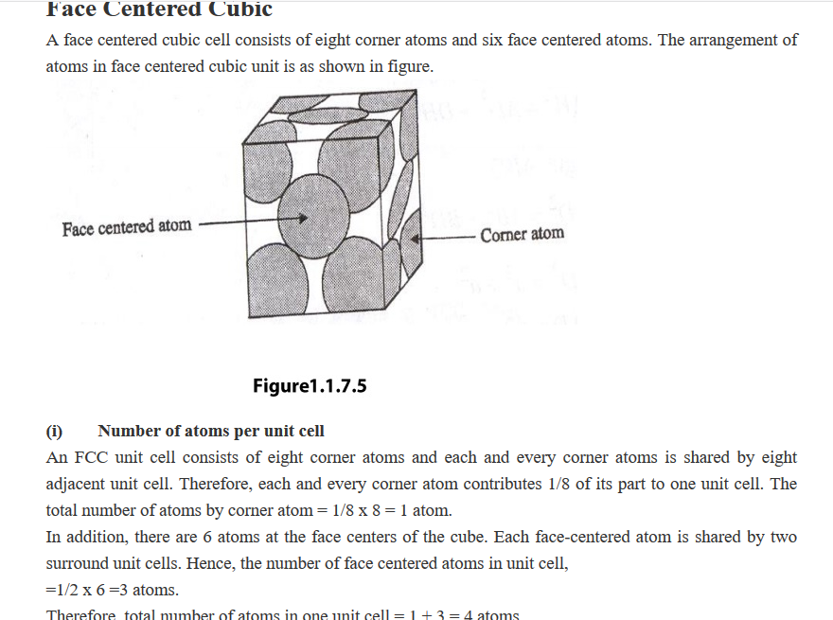
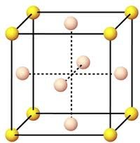
3. FCC

Slide 23
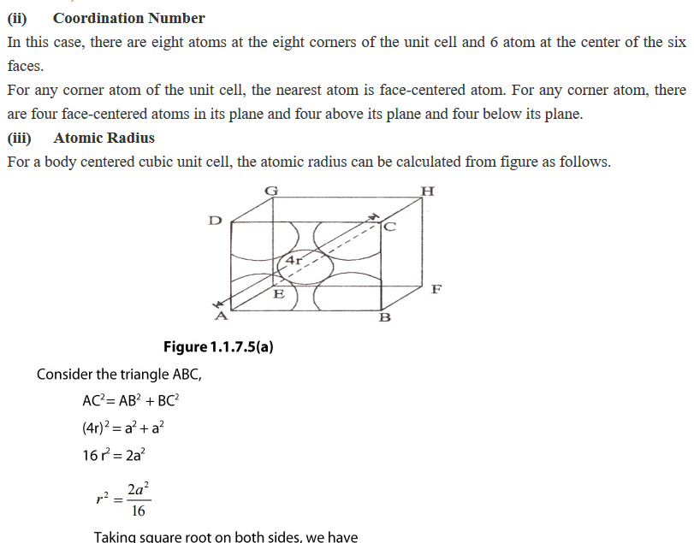

Slide 24
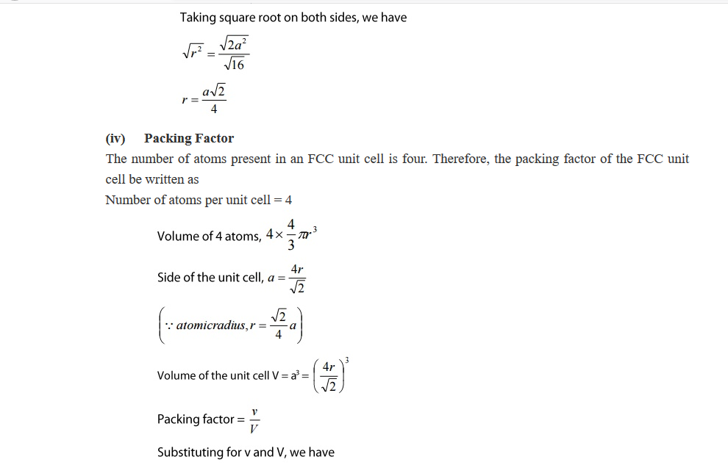

Slide 25
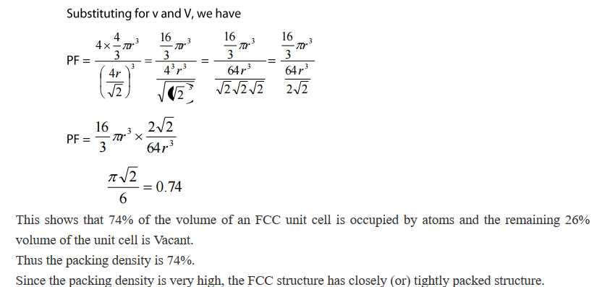
FCC

Slide 26
Lattice is defined as an array of points which are imaginarily kept to represent the position of atoms in the crystal that every lattice point has got the same environment as that o the other and hence one lattice point cannot be distinguished from the other lattice point.
Space Lattice or Crystal Lattice is a three dimensional collection of points in space. The environment about any particular point is in everyway the same.
The regular pattern of points which describe the three dimensional arrangement of particles in a crystal structure is called the Crystal Lattice or Space lattice.
Basis is formed by associating with every lattice point a uint of assembly of atoms or molecules identical in composition. This unit assembly is called Basis.
The Crystal Structure is formed by the addition of a basis to every lattice point.

Slide 27
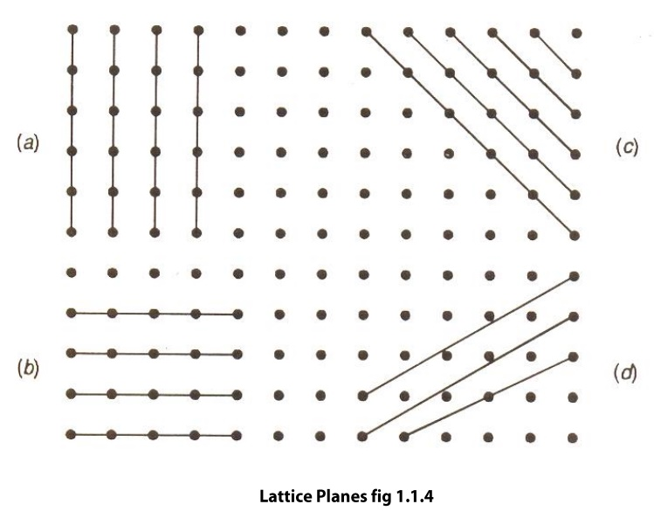
indices.
A crystal lattice may be considered as an aggregate of a set of parallel equi-distant planes of high density of lattices points, Hence lattice planes are also called Cleavage Points.
The lattice planes can be chosen in a different number of ways, for example (a), (b), (c), and (d) as shown in the figure.

Slide 28
Miller Indices
The problem is that how to designate a plane in the crystal. Miller evolved a method to designate a plane in a crystal by three numbers (h,k,l) known as Miller indices.
In a crystal, to express the inclination of a lattice plane with respect to three directions , Miller gave a method

Slide 29
Miller Indices
Miller introduced a system to designate a plane in a crystal. He introduced a set of three numbers to specify a plane a plane in a crystal. This set of three numbers is known as Miller Indices of the concerned plane.
Definition
•Miller indices are used to specify directions and planes.
•These directions and planes could be in lattices or in crystals.
•The number of indices will match with the dimension of the lattice or the crystal.
•E.g. in 1D there will be 1 index and 2D there will be two indices etc.

Slide 30
Procedure for finding Miler Indices
Determine the intercepts of the plane along the axes X, Y and Z in terms of the Lattice Constant a, b, c.
Determine the reciprocals of these numbers.
Find the least common denominator (LCD) and multiply each by this LCD . The result is written in the form (hkl) and is called the Miller Indices of the plane.

Slide 31
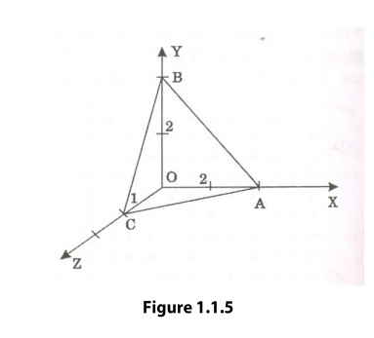
Miller Indices
Example
Plane ABC (figure 1.1.5) has intercepts of 2 axial units on X-axis, 2 axial units on Y-axis and 1 axial unit on Z-axis.
The reciprocals are ½,1/2 and 1. The LCM is 2.
Multiplying each by 2 , we get 1,1,2. Hence the Miller Indices of the plane are (112)

Slide 32
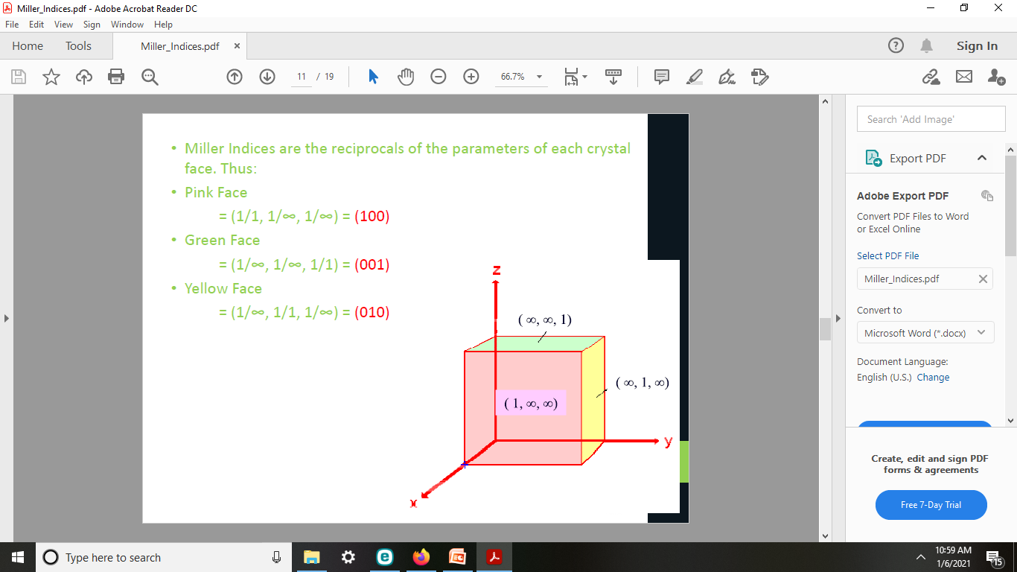
EXAMPLES:

Slide 33
Important Features of Miller Indices
When a plane is parallel to any axis, the intercept of the plane on that axis is infinity. Hence The Miller Indices for that axis zero.
If a plane cuts an axis on the negative side of the origin, corresponding index is negative.
The indices (hkl) do not define a particular plane but a set of parallel planes.
1 (a) Points to ponder
The Miller Indices should be enclosed only in this bracket.
There should not be any commas in between the numbers.
If the Miller Indices is say (2 6 3) means it should be read as two six three, and not as two hundred and sixty three.
The direction of plane can be represented by enclosing the Miller Indices in a square bracket. For example [2 6 3]
To represent the family of planes we can use this bracket i.e. ->
Putting a bar over the numbers can represent negative Miller Indices For an example (2 6 3) represents the plane with intercepts on negative axis, positive Y-axis and negative Z-axis.

Slide 34
